Slide 1
NLP Project – Sentiment Analysis Team Members Vikhyat Bansal [CB.EN.U4AIE21076] Rachit Agarwal [CB.EN.U4AIE21150]

Slide 2
TABLE OF CONTENTS
o1
04
02
05
03
06
Introduction
Methodology
About Dataset
Results
Literature Review
Reference

Slide 3
01
Introduction

Slide 4
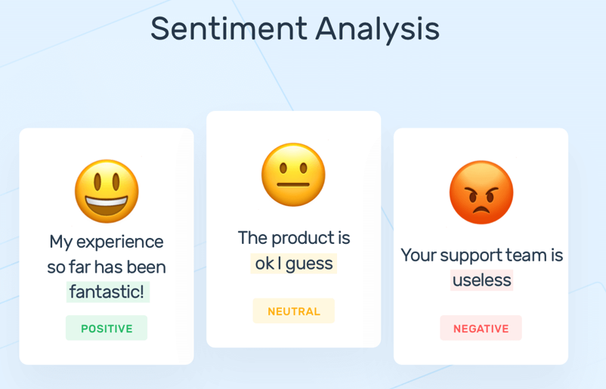
What is Sentiment Analysis ?
Sentiment analysis is a growing field at the intersection of linguistics and computer science that attempts to automatically determine the sentiment contained in text. Sentiment can be characterized as positive or negative evaluation expressed through language. Common applications of sentiment analysis include the automatic determination of whether a review posted online (of a movie, a book, or a consumer product) is positive or negative toward the item being reviewed. Sentiment analysis is now a common tool in the repertoire of social media analysis carried out by companies, marketers, and political analysts. Research on sentiment analysis extracts information from positive and negative words in text, from the context of those words, and from the linguistic structure of the text.

Slide 5
Problem Statement
Develop a sentiment analysis system capable of accurately classifying the sentiment expressed in English language text across various domains and contexts. The system should effectively distinguish between positive, negative, and neutral sentiments.
Can be applied on
Social Media Data
Product Review
Movie/TV Show Review
Customer Feedback

Slide 6

02
About Dataset

Slide 7
About Datasets
IMDB dataset having 50K movie reviews for natural language processing or Text analytics.
This is a dataset for binary sentiment classification containing substantially more data than previous benchmark datasets.It provide a set of 25,000 movie reviews for training and 25,000 for testing. So, predict the number of positive and negative reviews using either classification or deep learning algorithms.
A collection of 50,000 reviews from IMDB, allowing no more than 30 reviews per movie.
The constructed dataset contains an even number of positive and negative reviews, so randomly guessing
yields 50% accuracy.
Second dataset used is low resource Hindi language twitter sentiment. The dataset comprises of 10000 datapoints which contains 3 class labelled data such as positive, negative, neutral and some datapoint labelled as NaN. Dataset contained datapoints where hindi was written in English so after trimming NaN and un-usable datapoints, we were left with 1600 datapoints.

Slide 8
03
Literature Review

Slide 9
Prabha et al. analyzed various deep learning methods used in different applications at the level of sentence and aspect/object sentiment analysis, including Convolutional Neural Network (CNN), Recurrent Neural Network (RNN), and Long Short-term Memory (LSTM) (Prabha and Srikanth 2019). They discussed the advantages and disadvantages of these methods and their performance parameters. Ain et al. introduced deep learning techniques such as Deep Neural Network (DNN), CNN and Deep Belief Network (DBN) to solve sentiment analysis tasks like sentiment classification, cross-lingual problems, and product review analysis (Ain et al. 2017). Zhang et al. investigated deep learning and machine learning techniques for sentiment analysis in the contexts of aspect extraction and categorization, opinion expression extraction, opinion holder extraction, sarcasm analysis, multimodal data, etc. (Zhang et al. 2018).
Habimana et al. compared the performance of deep learning methods on specific datasets and proposed that performance could be improved using models including Bidirectional Encoder Representations from Transformers (BERT), sentiment-specific word embedding models, cognitive-based attention models, and commonsense knowledge (Habimana et al. 2020). Wang et al. reviewed and discussed existing analytical models for sentiment classification and proposed a computational emotion-sensing model (Wang et al. 2020b).

Slide 10
Some researchers also discussed web tools (Zucco et al. 2020), fuzzy logic algorithms (Serrano-Guerrero et al. 2021), transformer models (Acheampong et al. 2021), and sequential transfer learning (Chan et al. 2022) for sentiment analysis.
Birjali et al. have studied the most commonly used classification techniques in sentiment analysis from a large amount of literature and introduced the application areas and sentiment classification processes, including preprocessing and feature selection (Birjali et al. 2021).
They conducted a comprehensive analysis of the papers, discovering that supervised machine learning algorithms are the most commonly used techniques in the field. A complete review of methods and evaluation for sentiment analysis tasks and their applications was conducted by Wankhade et al. (2022). They compared the strengths and weaknesses of the methods, and discussed the future challenges of sentiment analysis in terms of both the methods and the forms of the data.

Slide 11
TABLE
Paper title | Author and Year | Focused Models | Metric | Accuracy
Survey of Sentiment Analysis Using Deep Learning Techniques | Prabha MI, Srikanth GU, 2019 | CNN , RNN, LSTM | Accuracy, Precison and Recall | Not mentioned
Study of machine learning techniques for sentiment analysis | Nair RR, Mathew J, Muraleedharan V, Deepa Kanmani S (2019) | Decision Tree, SVM, KNN, LTSM, Fuzzy, Random Forest, AdaBoost, Gradient Boosting | Accuracy, Precison and Recall | Refer Slide 13
Document-level sentiment analysis using attention-based bi-directional long short-term memory network and two-dimensional convolutional neural network. | Mao Y, Zhang Y, Jiao L, Zhang H (2022) | LSTM, 2D CNN | Accuracy, F1 and MSE | Refer Slide 14
A survey of sentiment analysis based on transfer learning | Liu R, Shi Y, Ji C, Jia M (2019) | CNN, RNN, Transfer Learning | Accuracy | Mentioned for different literatures

Slide 12
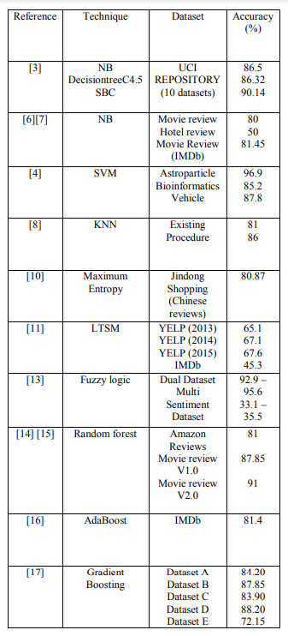
Paper - 2
Notes:
https://ieeexplore.ieee.org/stamp/stamp.jsp?tp=&arnumber=8819763

Slide 13
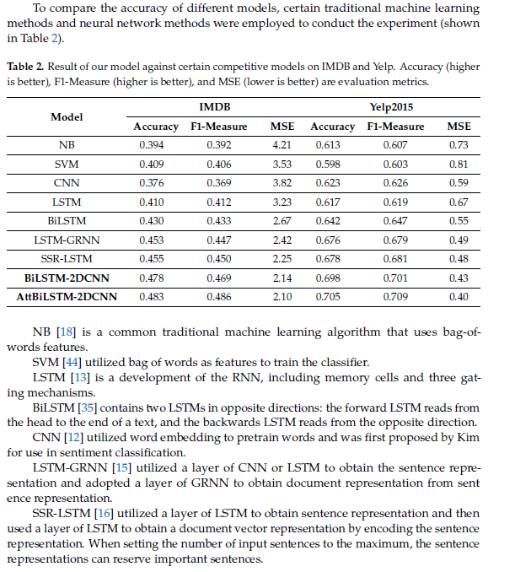
Paper - 3
Notes:
https://www.mdpi.com/search?q=sentiment+analysis

Slide 14
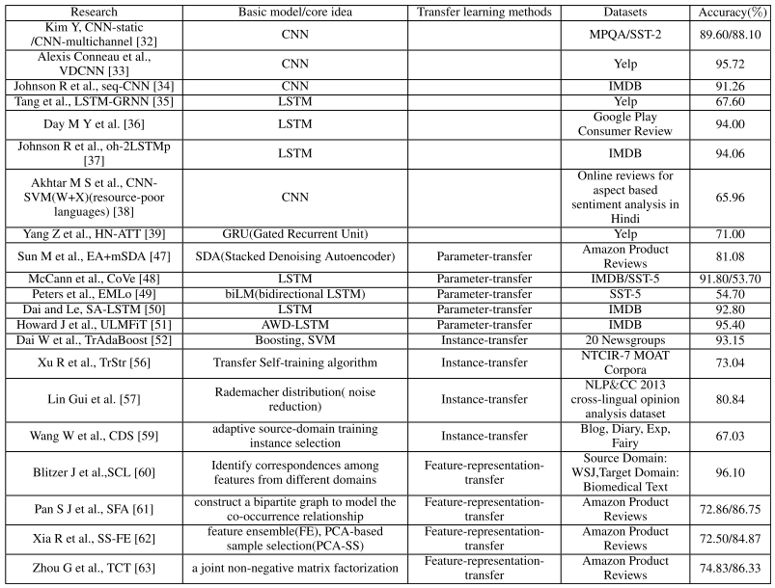
Paper - 4
Notes:
https://ieeexplore.ieee.org/stamp/stamp.jsp?tp=&arnumber=8746210

Slide 15
04
Methodology
PORTFOLIO 2023

Slide 16
HOW DO WE ACHIEVE RESULT?
Step 1
Step 2
Step 3
Step 4
Data Collection
Data Preprocessing
Generating Feature Vectors
Generating Word Embeddings {if needed}
Step 5
Step 6
Step 7
Step 8
Model Definition {CNN, NTK}
Training
Evaluation
Hyperparameter Optimization

Slide 17
Methodology
Data Collection:
Gather a diverse dataset of English language text containing labeled sentences with their corresponding sentiment categories (positive, negative).
Ensure the dataset covers various domains and contexts to capture different language patterns and sentiments.
Preprocessing:
Tokenize the sentences into individual words and remove punctuation, stop words, and other noise.
Convert words to their corresponding word vectors using pre-trained Word2Vec embeddings.
Word Embeddings:
Utilize pre-trained Word2Vec embeddings to convert each word in the sentence into a dense vector representation.
These embeddings capture semantic similarities between words, allowing the model to understand the meaning of words in the context of the sentence.
Generating Feature Vectors:
Using different traditional models like Bag of Words, N_Gram and for modern models we are using word2vec to do so.

Slide 18
Methodology
Defining Model {CNN, NTK}:
CNN: Ensuring that enough layers are there to capture the semantics and nuances of data, so that an accurate prediction can be made.
NTK: Ensuring that kernel with proper depth is created which can study the dynamics of data so that it can applied further on classifier
Training:
Split the dataset into training, validation, and test sets to train and evaluate the model's performance.
Train the CNN model using the training data and optimize its parameters using techniques such as stochastic gradient descent (SGD), Adam optimizer, or other optimization algorithms.
Monitor the model's performance on the validation set to prevent overfitting and adjust hyperparameters accordingly.
Evaluation:
Evaluate the trained model on the test set to assess its performance in classifying the sentiment of unseen sentences.
Use evaluation metrics such as accuracy, precision, recall, and F1-score to measure the model's effectiveness in sentiment classification.
Analyze misclassified examples to identify patterns or areas where the model can be improved.

Slide 19
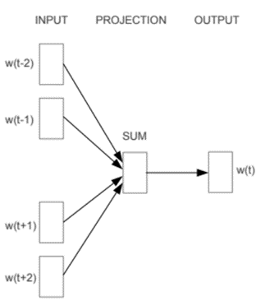
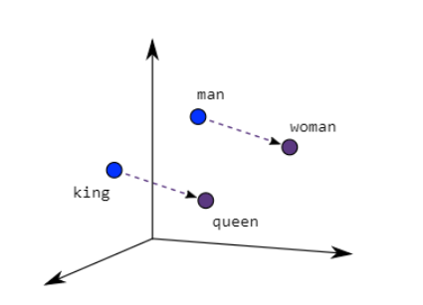
Word2Vec
Word2Vec creates vectors of the words that are distributed numerical representations of word features – these word features could comprise of words that represent the context of the individual words present in our vocabulary. Word embeddings eventually help in establishing the association of a word with another similar meaning word through the created vectors.

Slide 20
Two different model architectures that can be used by Word2Vec to create the word embeddings are the Continuous Bag of Words (CBOW) model & the Skip-Gram model.
Even though Word2Vec is an unsupervised model where you can give a corpus without any label information and the model can create dense word embeddings, Word2Vec internally leverages a supervised classification model to get these embeddings from the corpus. These embeddings are representations of words in a vector space, which are crucial for various natural language processing tasks and machine learning applications.
The CBOW architecture comprises a deep learning classification model in which we take in context words as input, X, and try to predict our target word, Y
For example, if we consider the sentence – “Word2Vec has a deep learning model working in the backend.”, there can be pairs of context words and target (center) words. If we consider a context window size of 2, we will have pairs like ([deep, model], learning), ([model, in], working), ([a, learning), deep) etc. The deep learning model would try to predict these target words based on the context words.

Slide 21
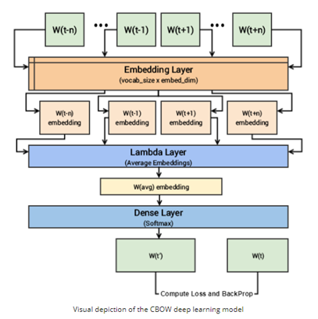
The following steps describe how the model works:
The context words are first passed as an input to an embedding layer (initialized with some random weights) as shown in the Figure below.
The word embeddings are then passed to a lambda layer where we average out the word embeddings.
We then pass these embeddings to a dense SoftMax layer that predicts our target word. We match this with our target word and compute the loss and then we perform backpropagation with each epoch to update the embedding layer in the process.
We can extract out the embeddings of the needed words from our embedding layer, once the training is completed.
For example, if we consider the sentence – “Word2Vec has a deep learning model working in the backend.”, there can be pairs of context words and target (center) words. If we consider a context window size of 2, we will have pairs like ([deep, model], learning), ([model, in], working), ([a, learning), deep) etc. The deep learning model would try to predict these target words based on the context words.

Slide 22
Traditional method for feature vector
Bag of Words (BoW)
The Bag of Words model is a simple and widely used method to represent text data. It converts a document (or a corpus of documents) into a collection of words, disregarding grammar and word order but keeping multiplicity.
Process:
Tokenization: Split the text into individual words (tokens).
Vocabulary Creation: Build a vocabulary of all unique words in the corpus.
Vector Representation: Represent each sentence as a vector of word frequencies (counts of each word from the vocabulary in the document).
Example:
Consider two sentences:
Text1: "The cat sat on the mat."
Text2: "The dog lay on the rug."
Vocabulary: {"the", "cat", "sat", "on", "mat", "dog", "lay", "rug"}
Text1 vector: [2, 1, 1, 1, 1, 0, 0, 0]
Text2 vector: [2, 0, 0, 1, 0, 1, 1, 1]

Slide 23
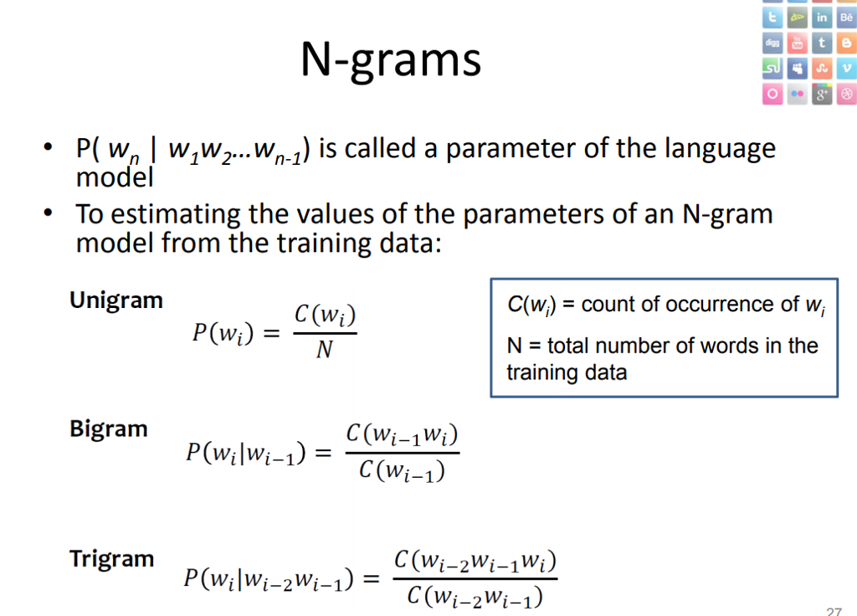
Traditional method for feature vector

Slide 24
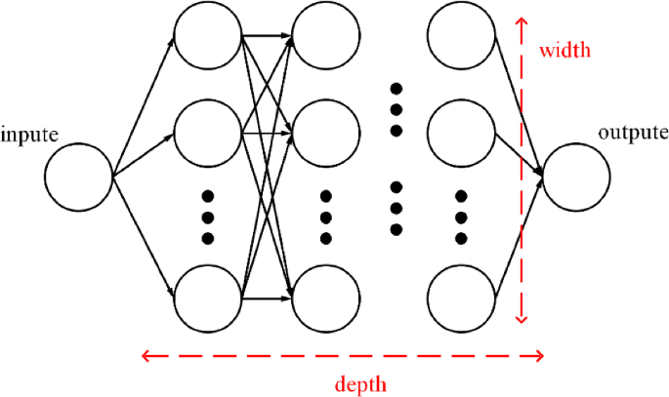
NTK Architecture

Slide 25
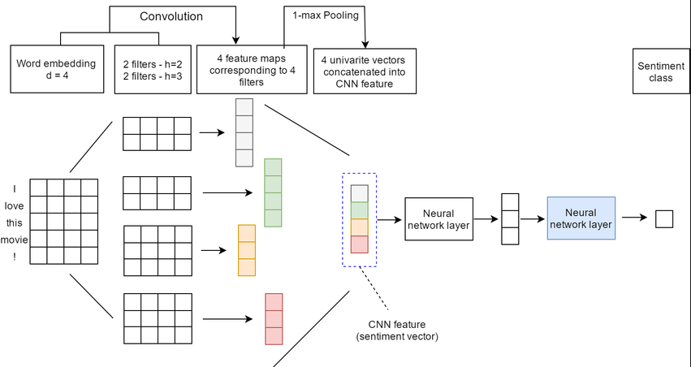
CNN Architecture

Slide 26
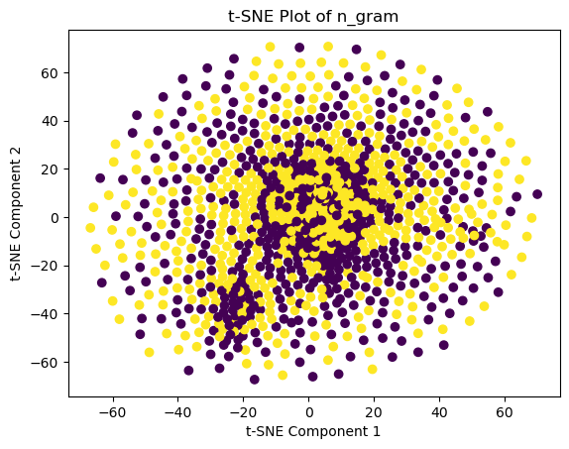
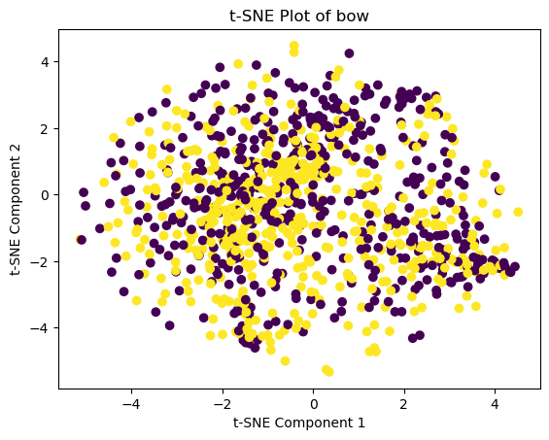
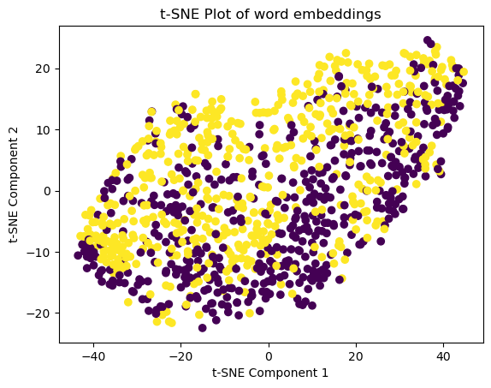
T-SNE Plots
Figure 1(a)
Figure 1(b)
Figure 1(c)
Figure 1(a) is t-SNE plot for IMDB dataset first 1000 datapoints using n_gram,
Figure 1(b) is t-SNE plot for IMDB dataset first 1000 datapoints using bag of words,
Figure 1(c) is t-SNE plot for IMDB dataset first 1000 datapoints using word2vec generated word embeddings.

Slide 27
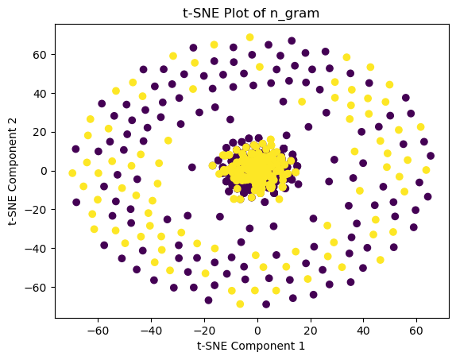
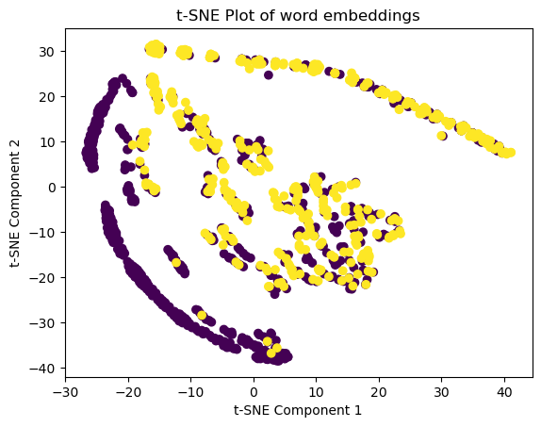
T-SNE Plots
Figure 2(a)
Figure 2(b)
Figure 2(c)
Figure 2(a) is t-SNE plot for hindi dataset first 1000 datapoints using n_gram,
Figure 2(b) is t-SNE plot for hindi dataset first 1000 datapoints using bag of words,
Figure 2(c) is t-SNE plot for hindi dataset first 1000 datapoints using word2vec generated word embeddings.

Slide 28
05
Result

Slide 29
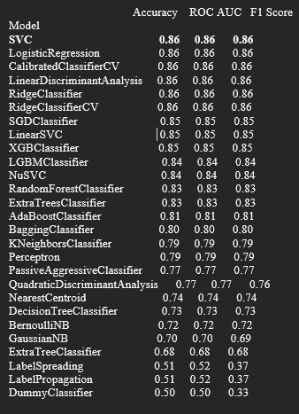
Performance Metrics {IMDB Dataset} {Traditional ML algorithms}

Slide 30
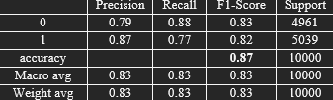
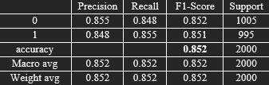
Performance Metrics {IMDB Dataset} {CNN with word embeddings}
Performance Metrics {IMDB Dataset} {SVM with NTK}

Slide 31
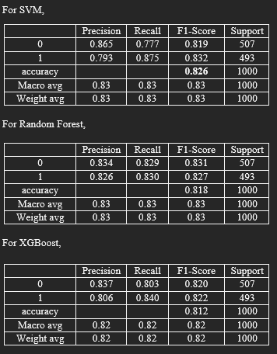
Performance Metrics {IMDB Dataset} {ML algos with Bag of Words}

Slide 32
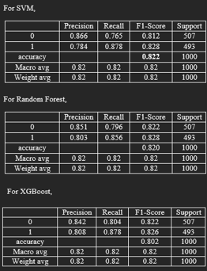
Performance Metrics {IMDB Dataset} {ML algos with n_gram}

Slide 33
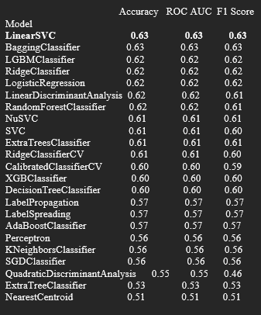
Performance Metrics {Hindi Dataset} {Traditional ML algorithms}

Slide 34
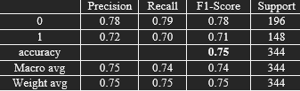
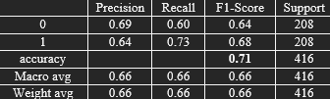
Performance Metrics {Hindi Dataset} {CNN with word embeddings}
Performance Metrics {Hindi Dataset} {SVM with NTK}

Slide 35
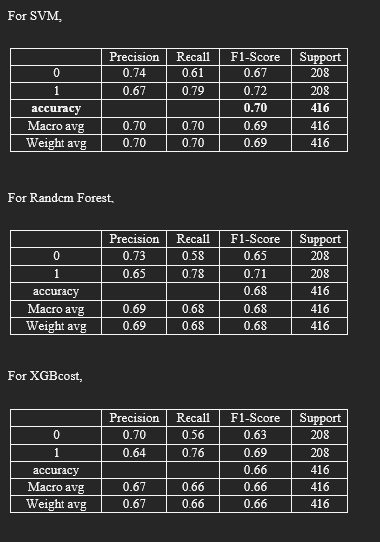
Performance Metrics {Hindi Dataset} {ML algos with Bag of Words}

Slide 36
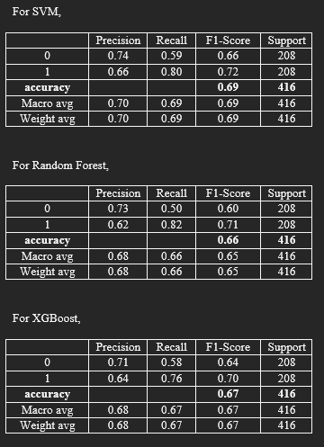
Performance Metrics {Hindi Dataset} {ML algos with n_gram}

Slide 37
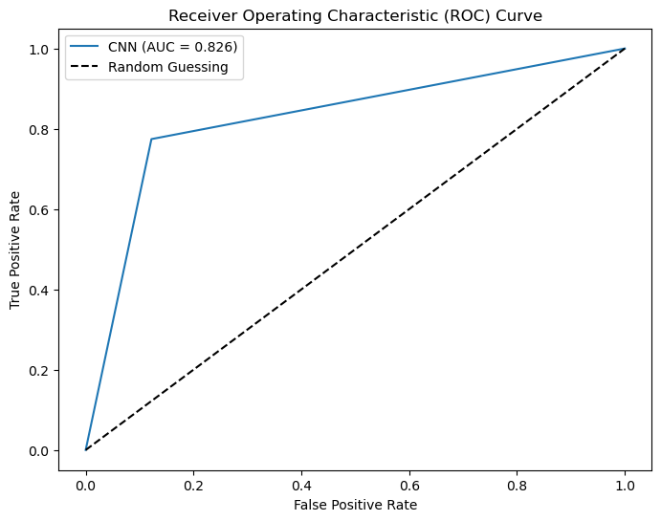
ROC – AUC Curve
Figure 3(a)
Figure 3(a) represents ROC-AUC curve for CNN model applied on word embeddings generated for IMDB dataset.

Slide 38
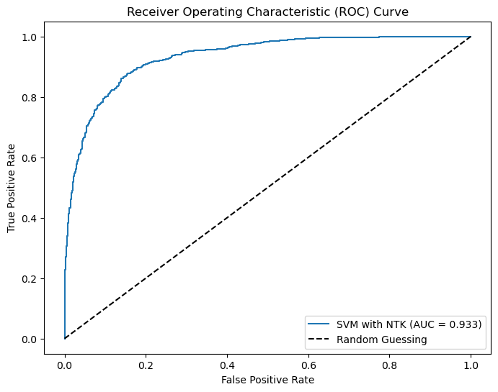
ROC – AUC Curve
Figure 3(b)
Figure 3(b) represents ROC-AUC for SVM classifier used on Neural Tangent Kernel applied on word embeddings generated for IMDB dataset.

Slide 39
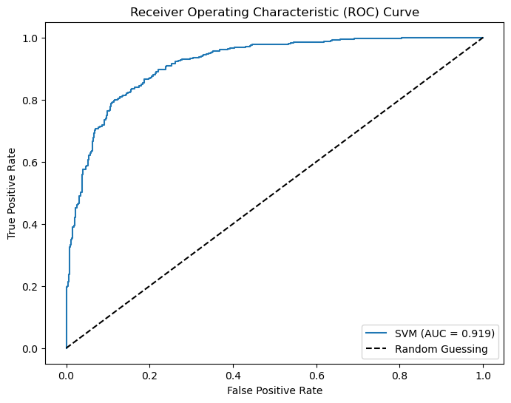
ROC – AUC Curve
Figure 3(c)
Figure 3(c) represents ROC-AUC curve for best model (SVM) out of 3 models applied on BoW generated for IMDB dataset.

Slide 40
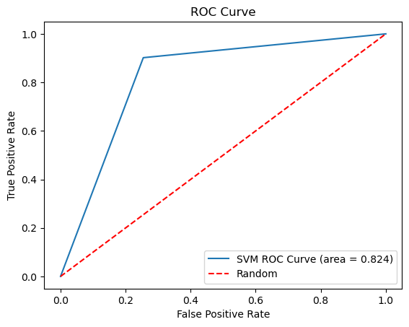
ROC – AUC Curve
Figure 3(d)
Figure 3(d) represents ROC-AUC curve for best model (SVM) out of 3 models applied on n_gram generated for IMDB dataset.

Slide 41
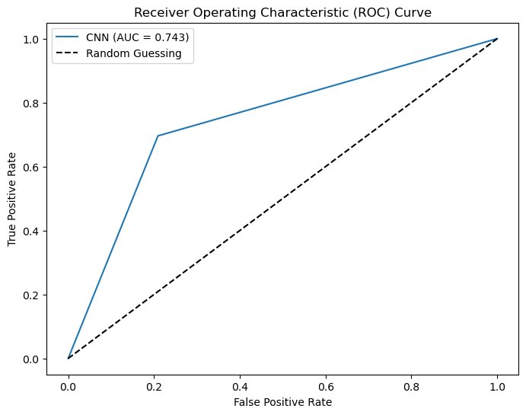
ROC – AUC Curve
Figure 4(a)
Figure 4(a) represents ROC-AUC curve for CNN model applied on word embeddings generated for hindi dataset

Slide 42
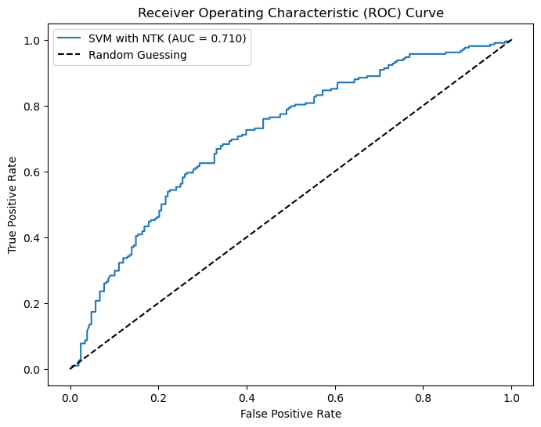
ROC – AUC Curve
Figure 4(b)
Figure 4(b) represents ROC-AUC curve for SVM classifier used on Neural Tangent Kernel applied on word embeddings generated for hindi dataset.

Slide 43
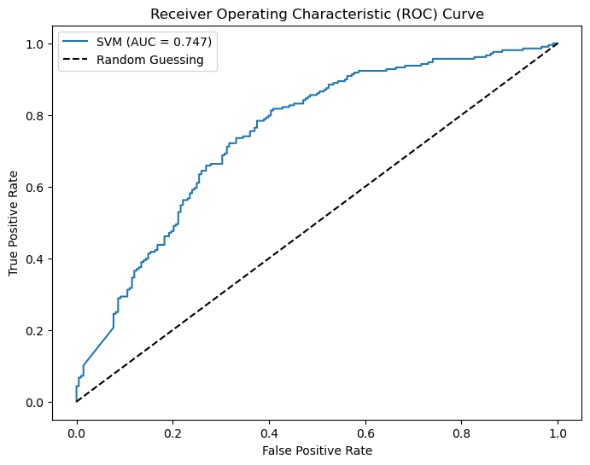
ROC – AUC Curve
Figure 4(c)
Figure 4(c) represents ROC-AUC curve for best model (SVM) out of 3 models applied on BoW generated for hindi dataset.
.

Slide 44
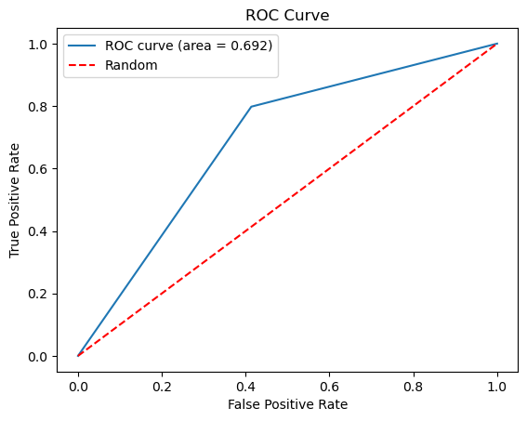
ROC – AUC Curve
Figure 4(d)
Figure 4(d) represents ROC-AUC curve for best model (SVM) out of 3 models applied on n_gram generated for hindi dataset.

Slide 45
06
References

Slide 46
REFERENCES
Marouane Birjali, Mohammed Kasri, Abderrahim Beni-Hssane, A comprehensive survey on sentiment analysis: Approaches, challenges and trends,Knowledge-Based Systems,Volume 226, 2021, 107134, ISSN 0950-7051, https://doi.org/10.1016/j.knosys.2021.107134.
A systematic literature review on machine learning applications for consumer sentiment analysis using online reviews Praphula Kumar Jain a,∗ , Rajendra Pamula a , Gautam Srivastava b,2021
Multimodal Sentiment Analysis: A Survey of Methods, Trends, and Challenges
Sanjeev Verma,Sentiment analysis of public services for smart society: Literature review and future research directions,Government Information Quarterly,Volume 39, Issue 3,2022,101708,ISSN 0740-624X, https://doi.org/10.1016/j.giq.2022.101708.
Wankhade, M., Rao, A.C.S. & Kulkarni, C. A survey on sentiment analysis methods, applications, and challenges. Artif Intell Rev 55, 5731–5780 (2022). https://doi.org/10.1007/s10462-022-10144-1

